Slide 1
Bike Rental Prediction using R
Mohammad Azaan
Email – mohdazaan297@gmail.com
Phone – 8057717406
Current Location – New Delhi, 110025
Immediate Joiner

Slide 2
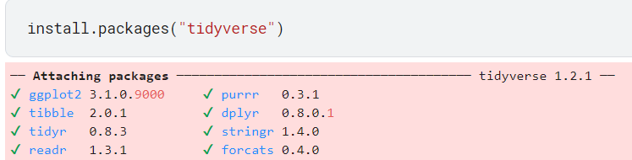
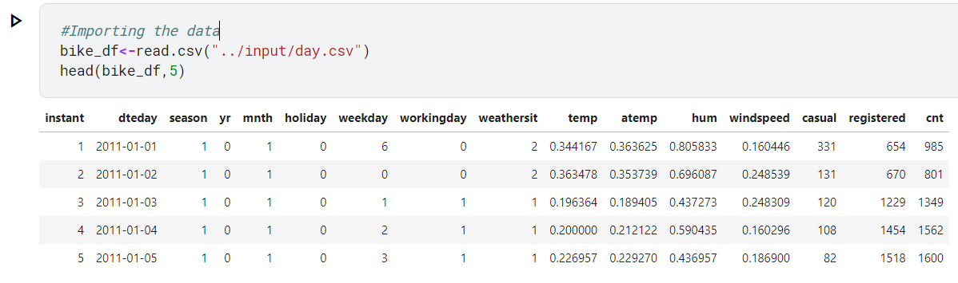
Task 1. Exploratory data analysis: • Load the dataset and the relevant libraries

Slide 3
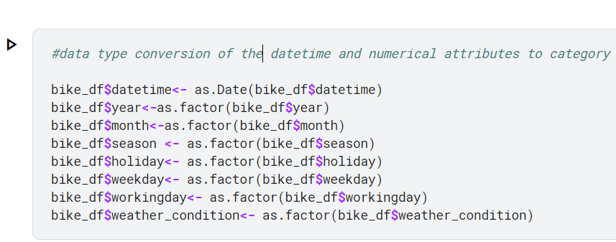
• Perform data type conversion of the attributes

Slide 4
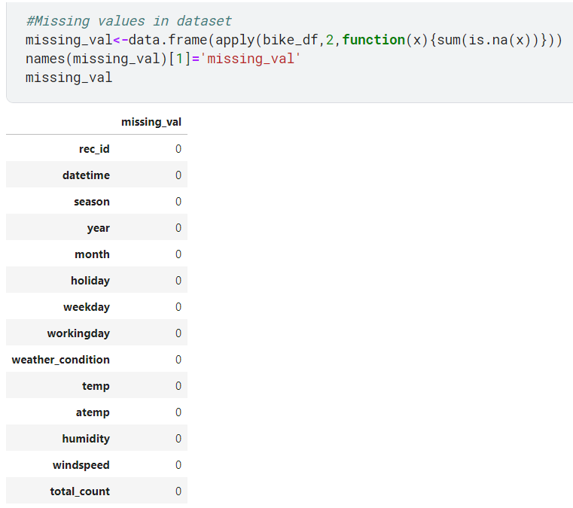
• Carry out the missing value analysis

Slide 5
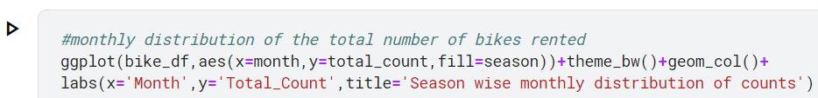
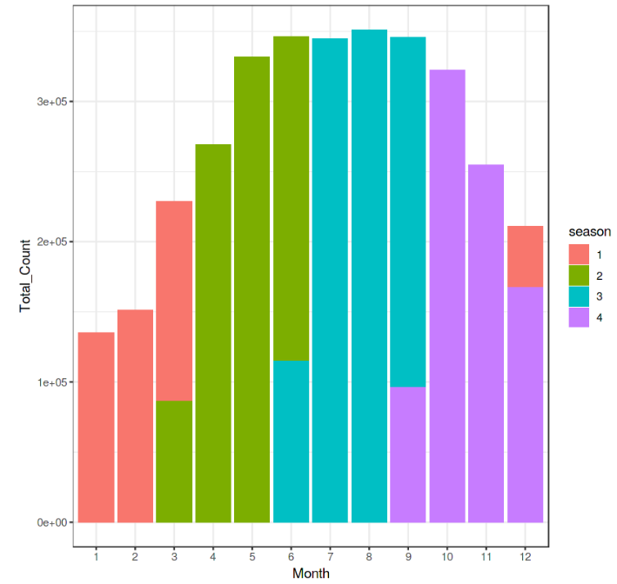
Task 2. Attributes distribution and trends • Plot monthly distribution of the total number of bikes rented

Slide 6
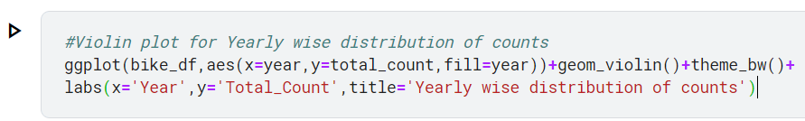
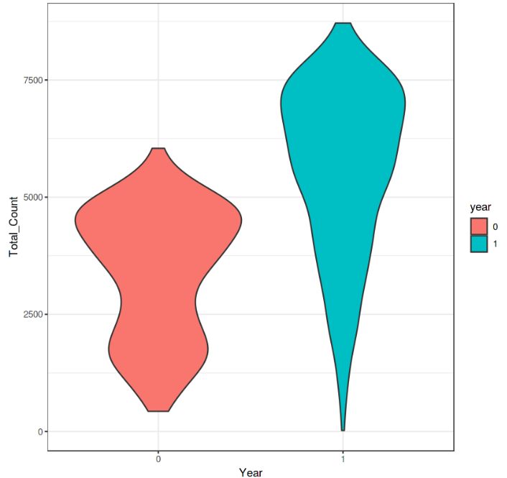
• Plot yearly distribution of the total number of bikes rented

Slide 7
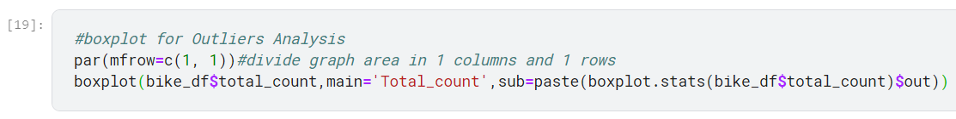
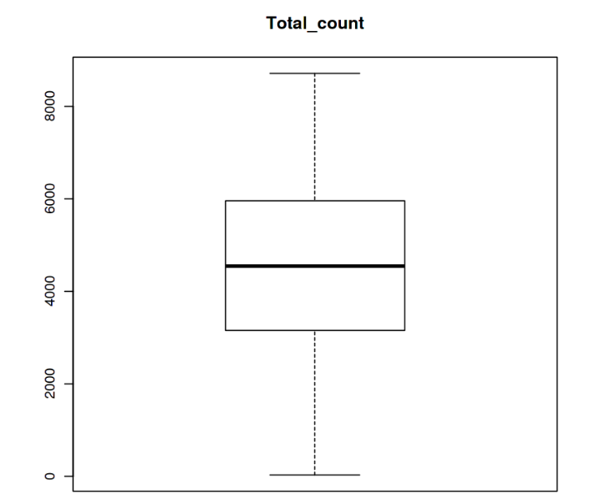
• Plot boxplot for outliers' analysis

Slide 8
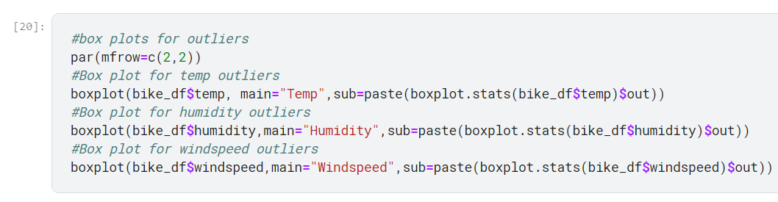
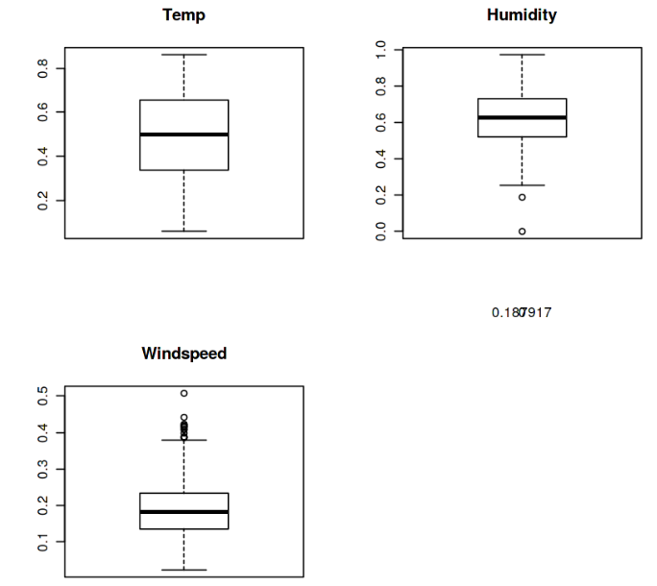

Slide 9
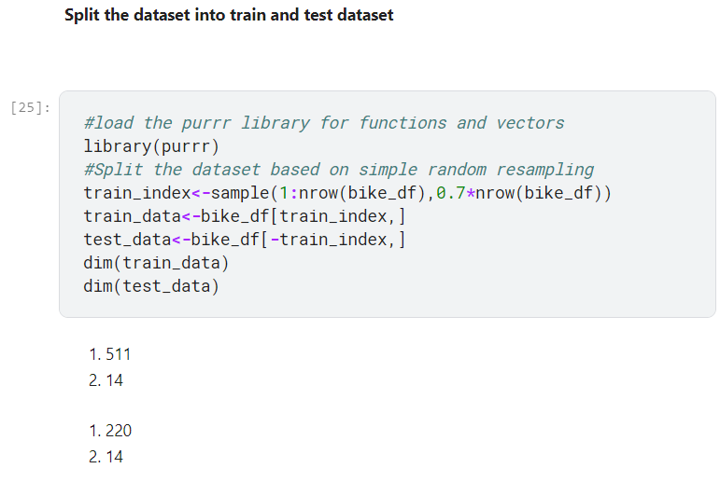
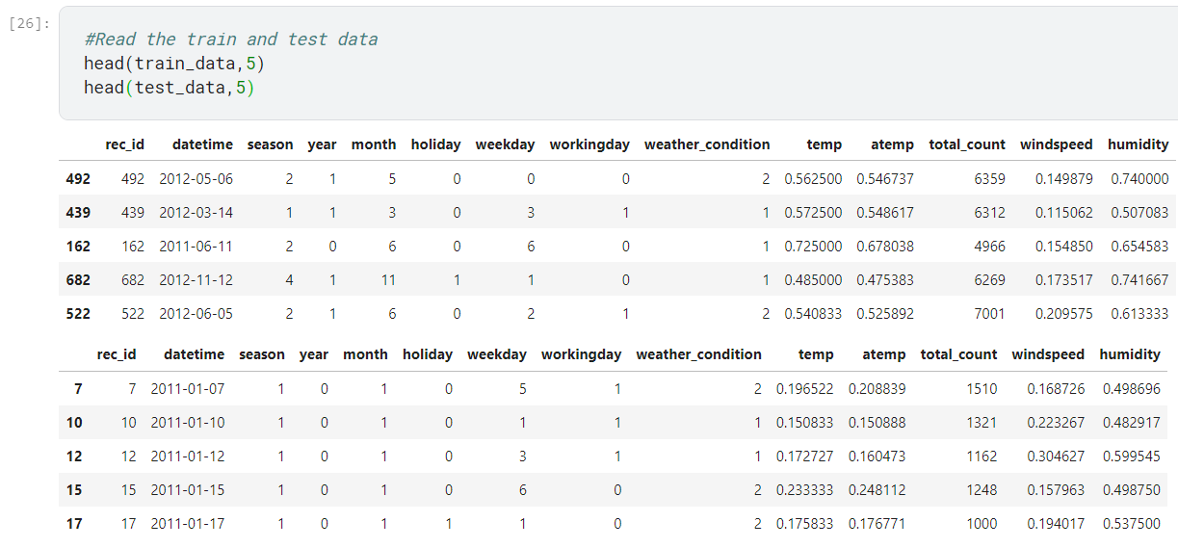
Task 3. Split the dataset into train and test dataset

Slide 10
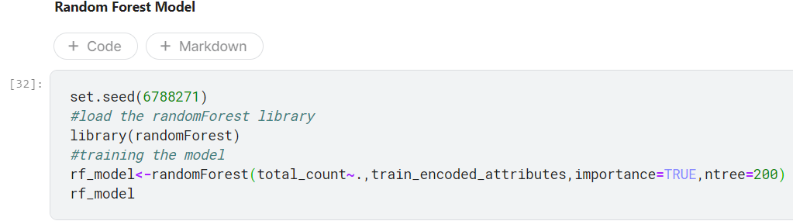
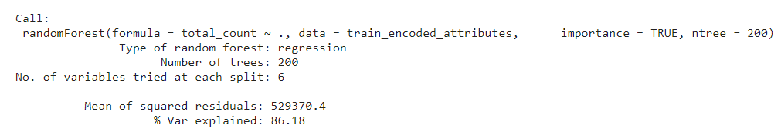
Task 4. Create a model using the random forest algorithm

Slide 11
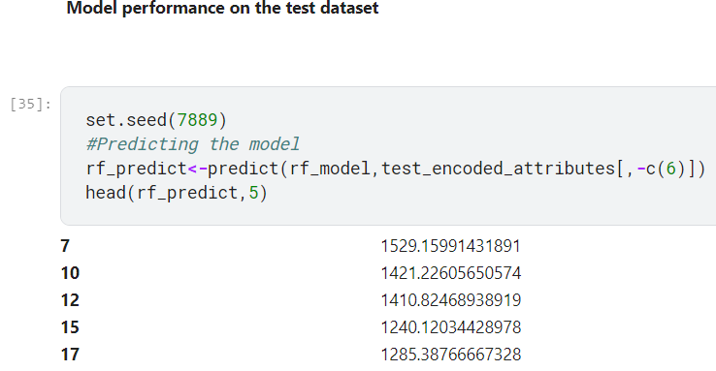
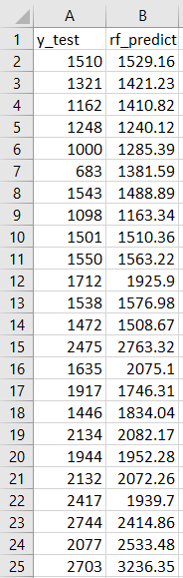
Task 5. Predict the performance of the model on the test dataset

